Slide 1
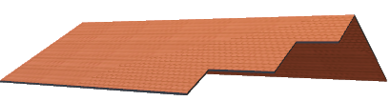
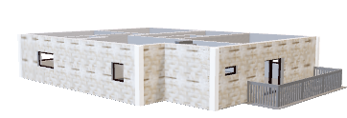
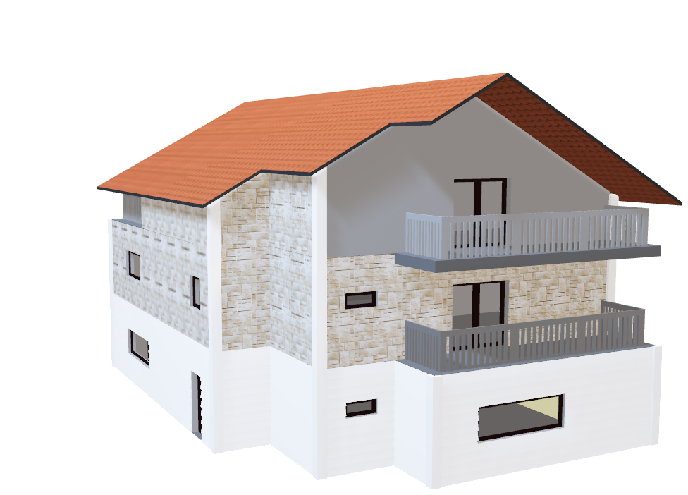
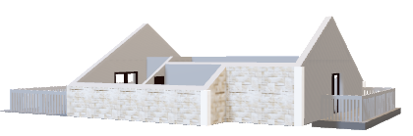
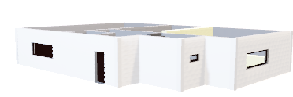
Smart Home Project
Group Information
Name: Bappy Id: 202039611
Name: Akbarjon Id: 202039098
Home automation or demotics is building automation for a home, called a smart home or smart house. A home automation system will monitor and/or control home attributes such as lighting, climate, entertainment systems, and appliances. It may also include home security such as access control and alarm systems.

Slide 2
Contents
Humidity and temperature sensor
Flame sensor
Buzzer sensor
Touch sensor
Button sensor
LED sensor
Camera

Slide 3
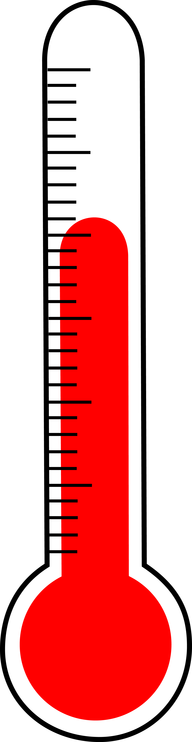
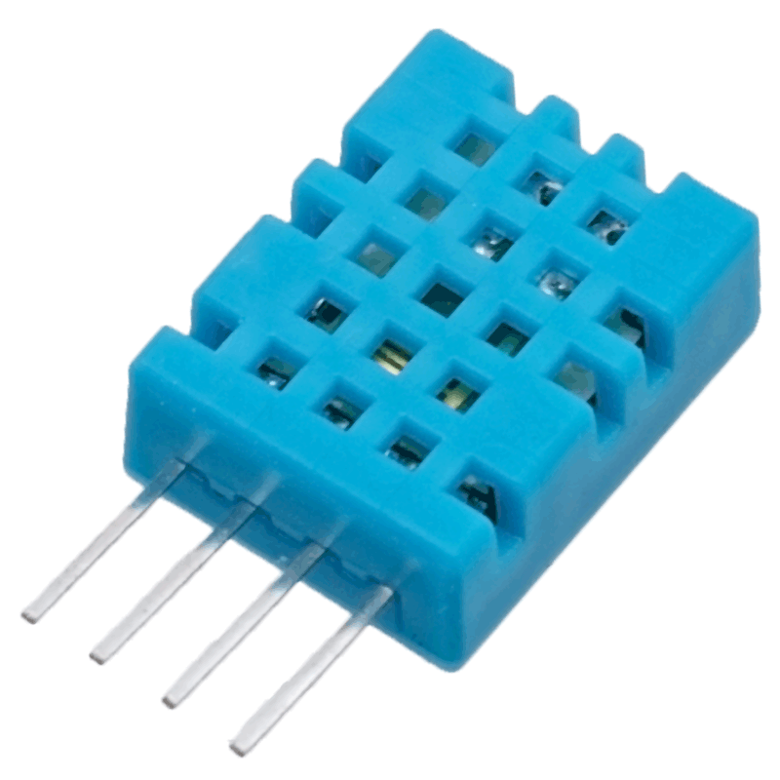
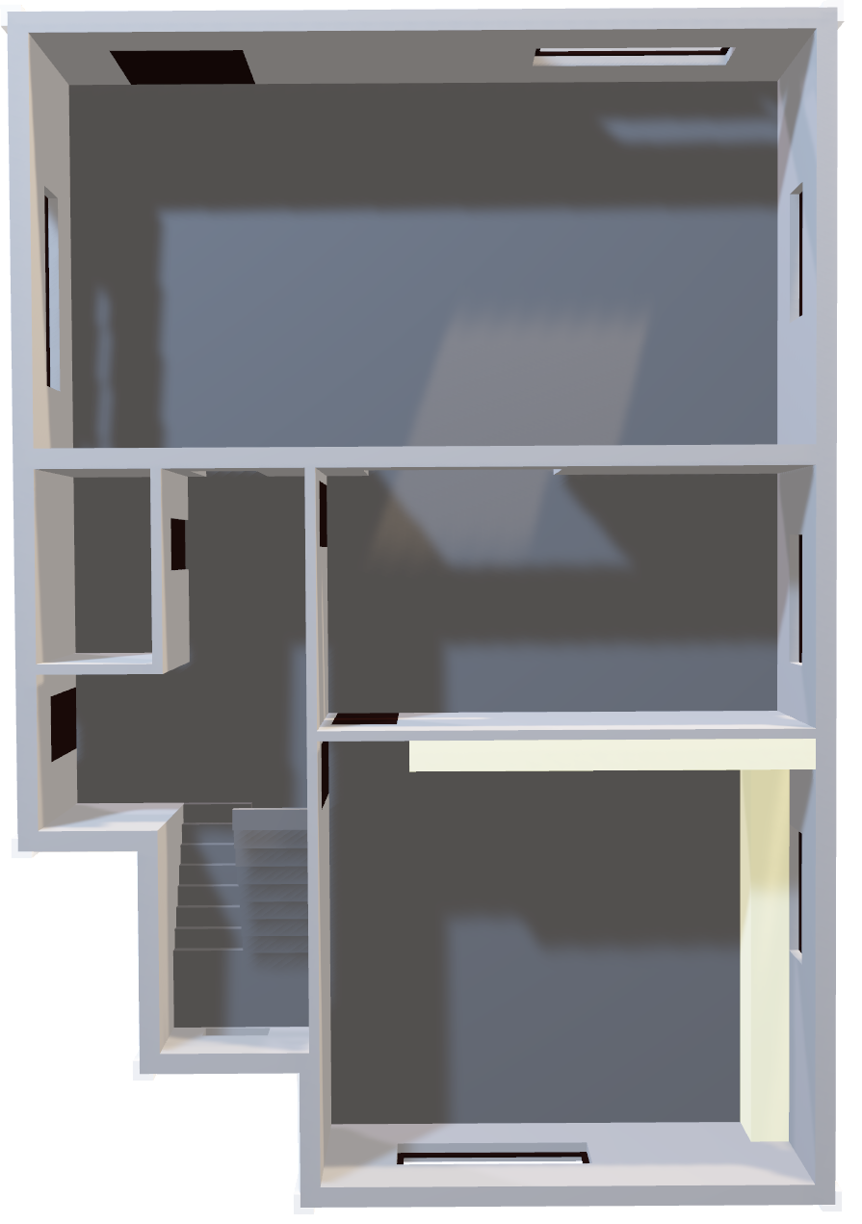
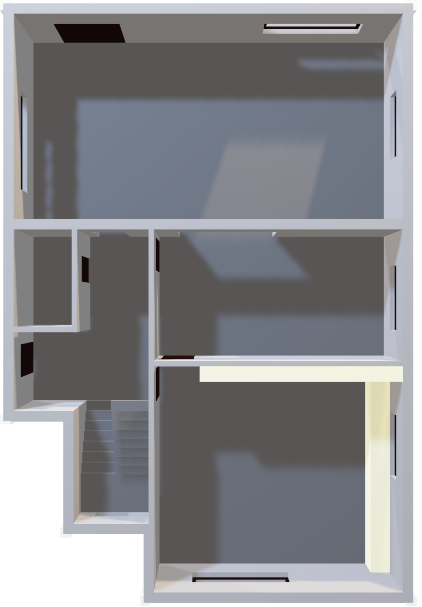
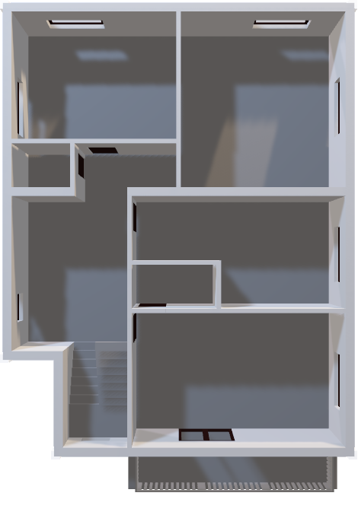
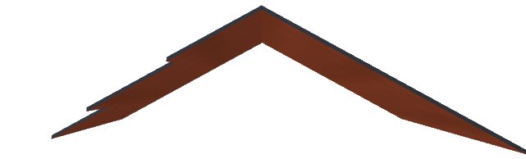
humidity and temperature sensor
Roof
The humidity sensor that can also calculate the temperature of an area. This sensor has a relatively long transmission distance, allowing the sensor to transmit data through wires up to 20m away from the Raspberry Pi.
3rd Floor
2nd Floor

Slide 4

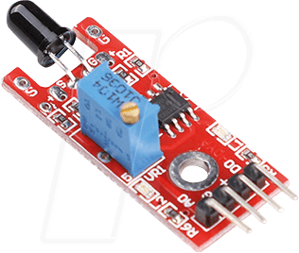
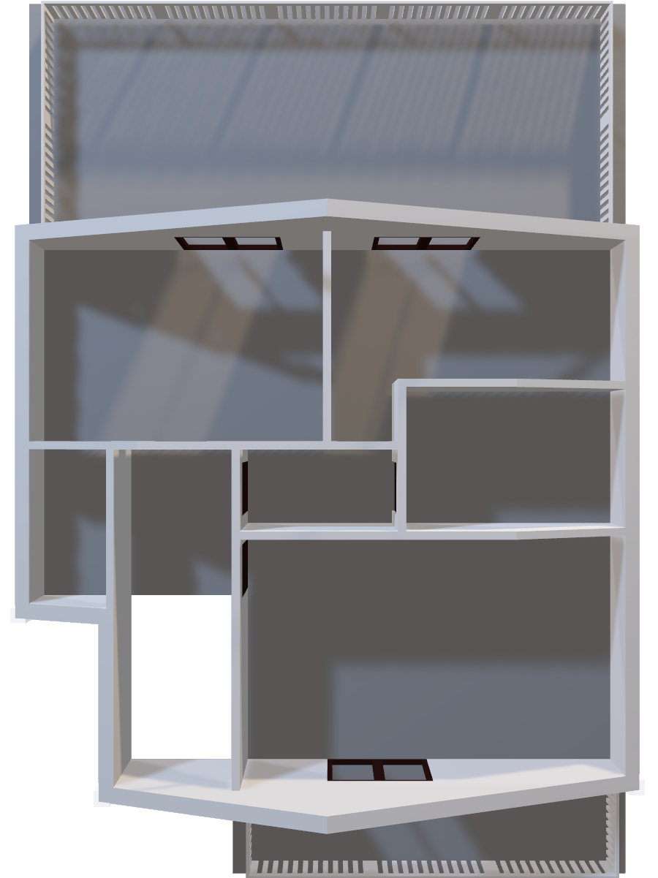
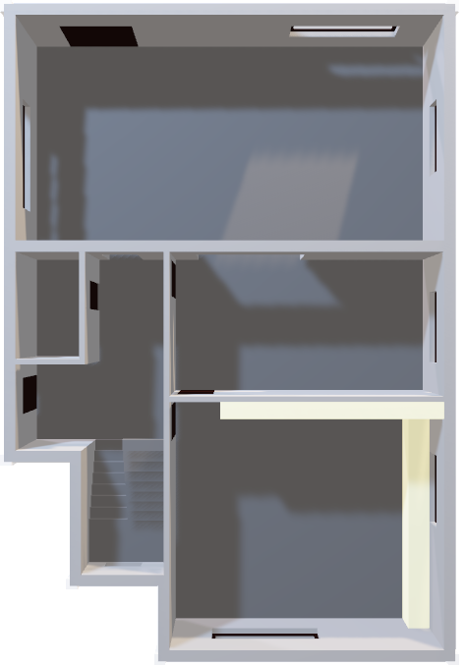
Flame sensor
Roof
Flame can detect infrared light with a wavelength ranging from 700nm to 1000nm. The far-infrared flame probe converts the light detected in the form of infrared light into current changes. Sensitivity is adjusted through the onboard variable resistor with a detection angle of 60 degrees.
2nd Floor
1st Floor

Slide 5
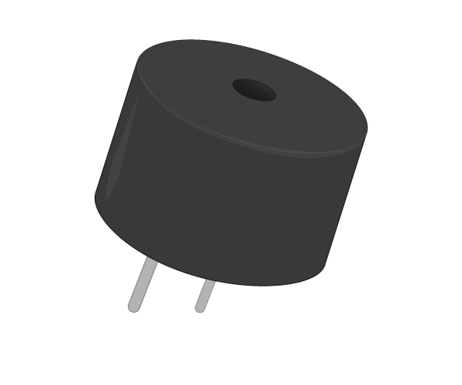
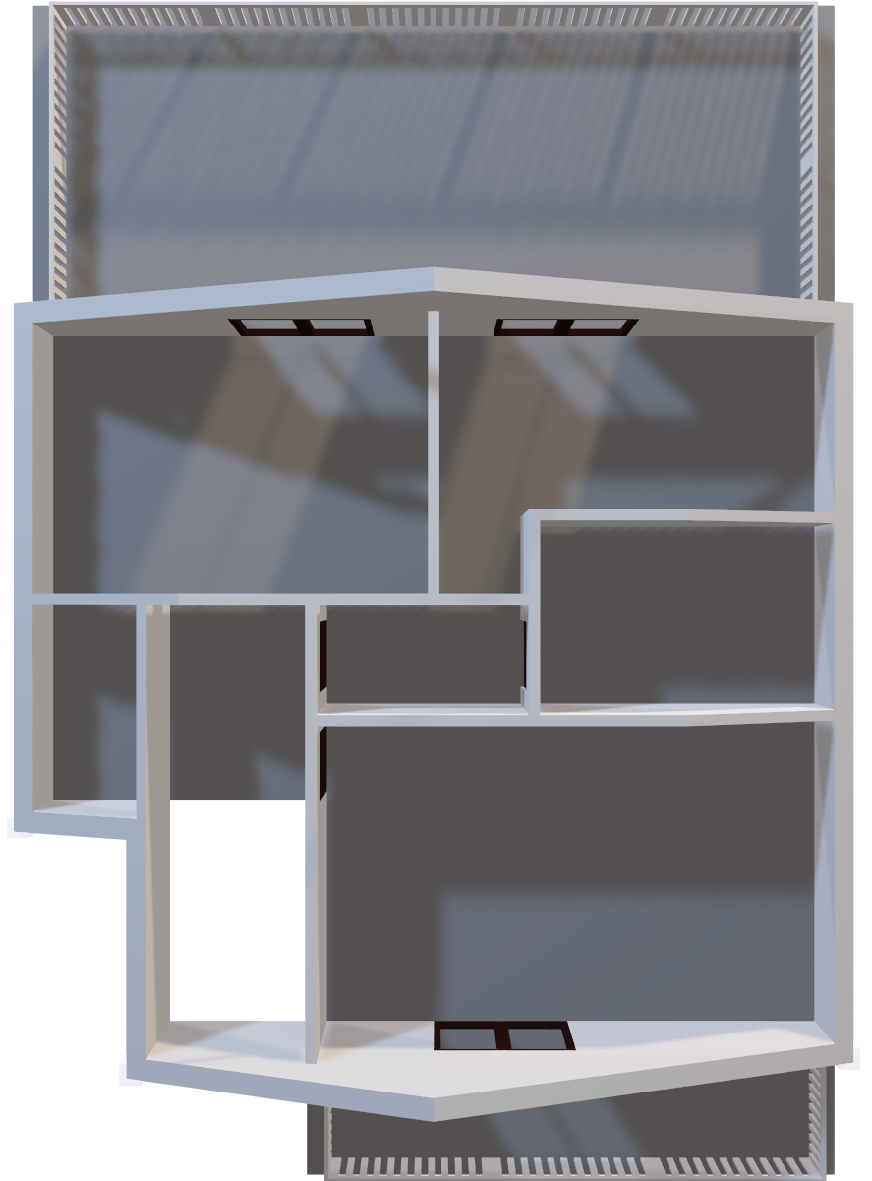
Buzzer Sensor
A buzzer or beeper is an audio signaling device, which may be mechanical, electromechanical, or piezoelectric (piezo for short). Typical uses of buzzers and beepers include alarm devices, timers, train and confirmation of user input such as a mouse click or keystroke.

Slide 6
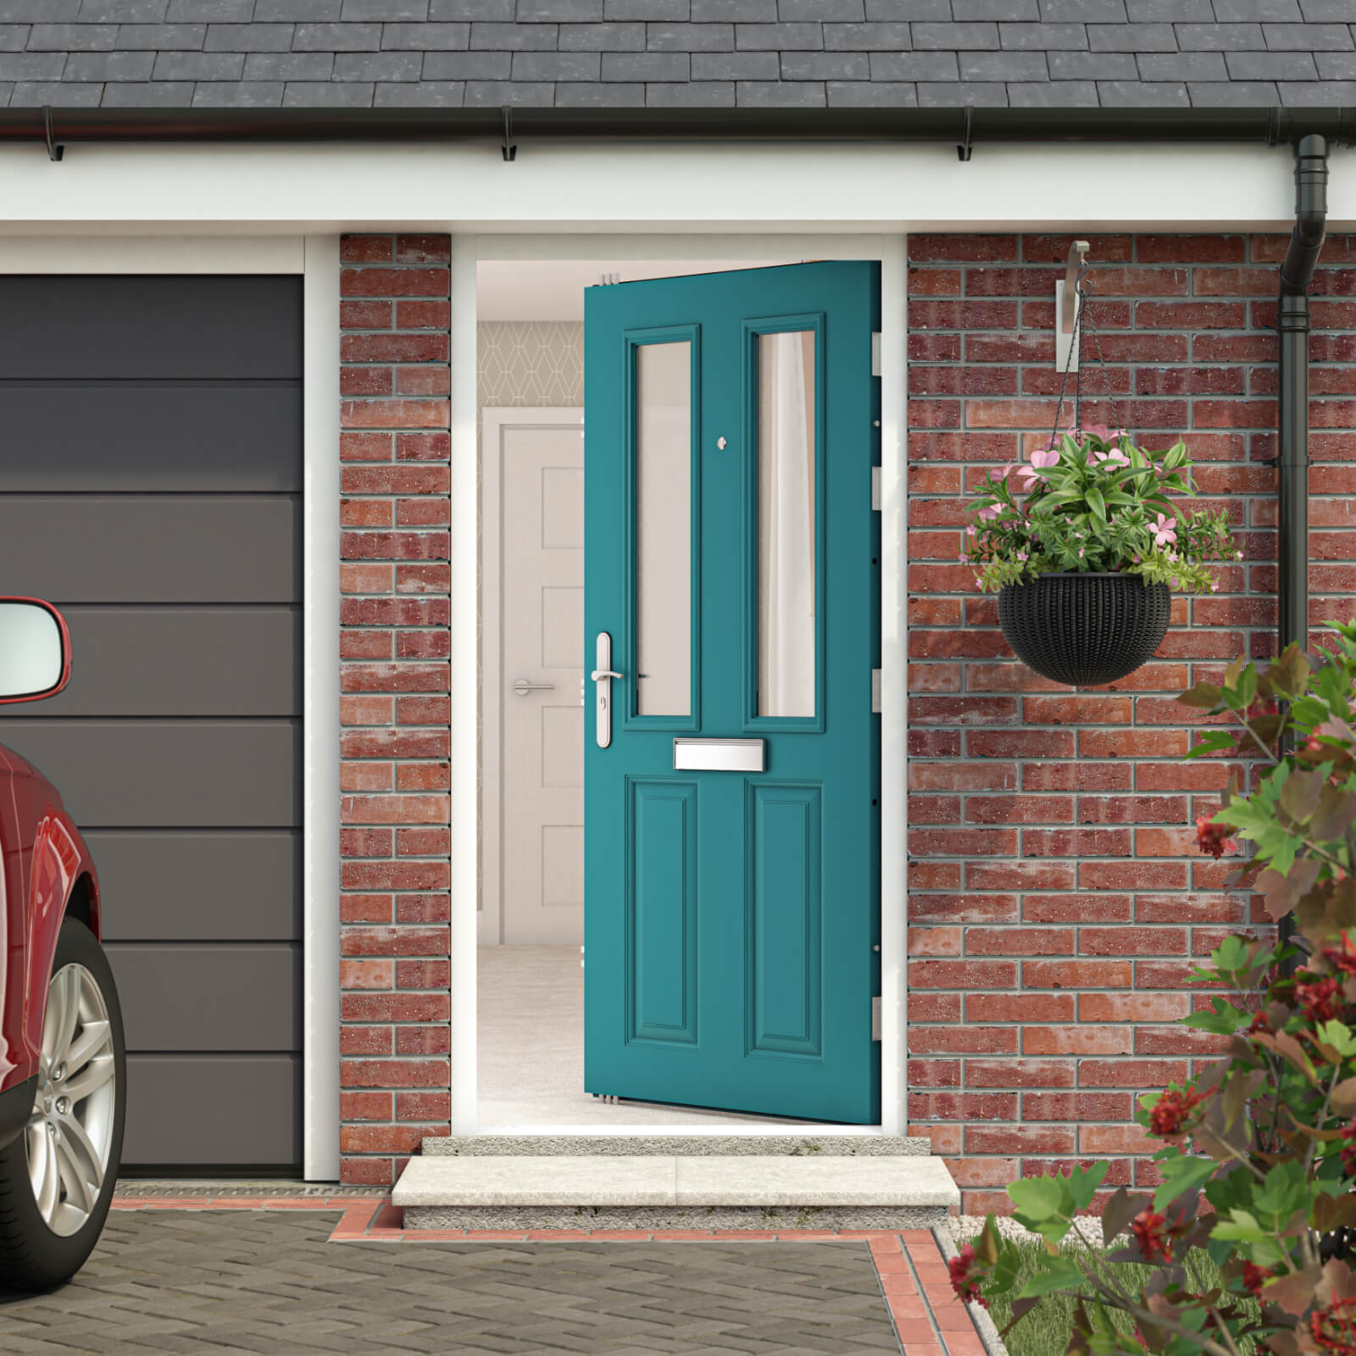
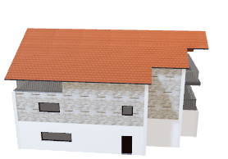
Touch Sensor
A touch sensor is a type of device that captures and records physical touch or embrace on a device and/or object. It enables a device or object to detect touch or near proximity, typically by a human user or operator.

Slide 7
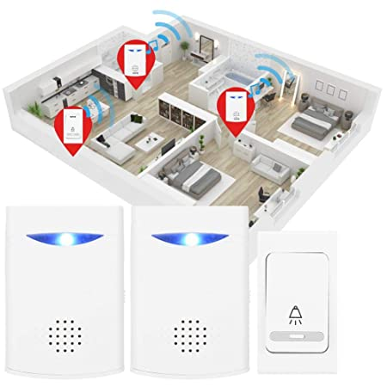
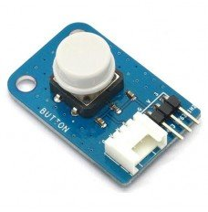
Button Sensor
Connecting the Raspberry Pi's general purpose input output ports (GPIO) to a momentary tactile push button switch is a fairly simple circuit.
Button switches are an input. The button sends a signal which is received by the Raspberry Pi to be processed. The LEDs, buzzers, and Scratch games project used the GPIO (General-Purpose Input/Output) pins along the top of a Raspberry Pi to control simple electronic outputs, such as LEDs and buzzers.

Slide 8
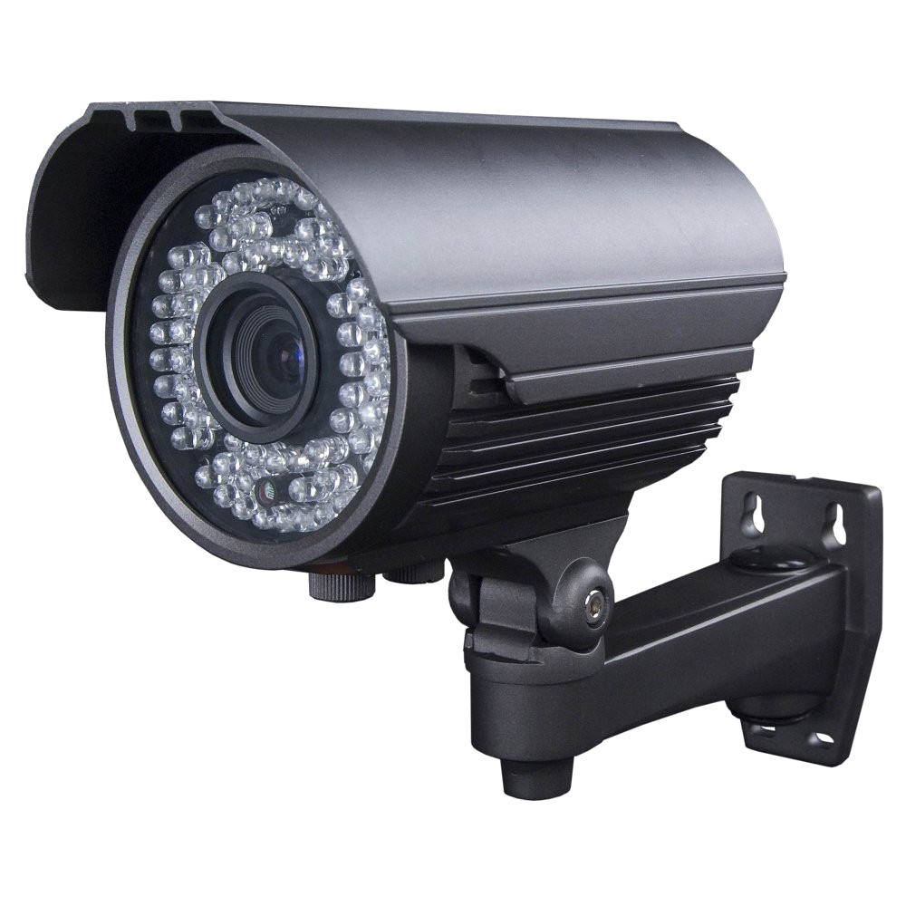
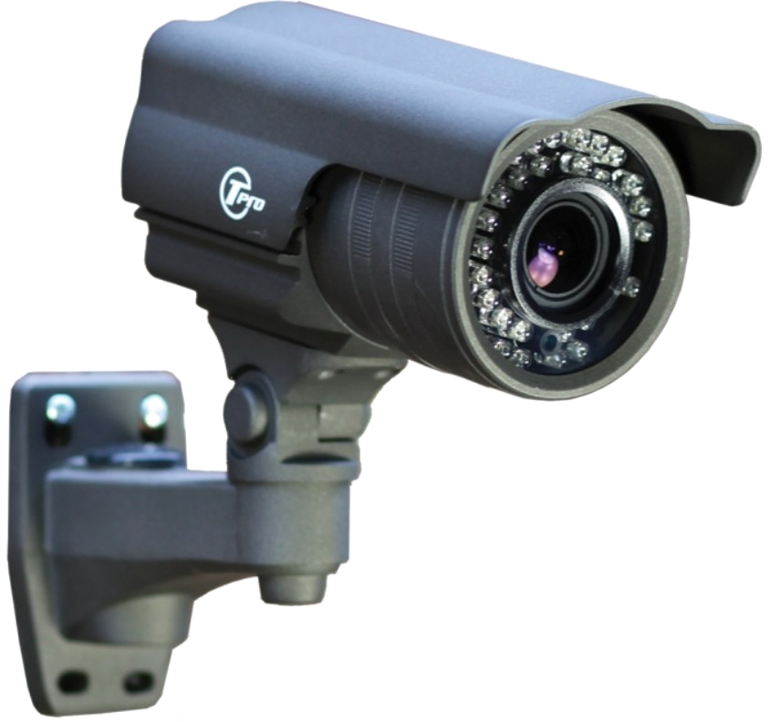
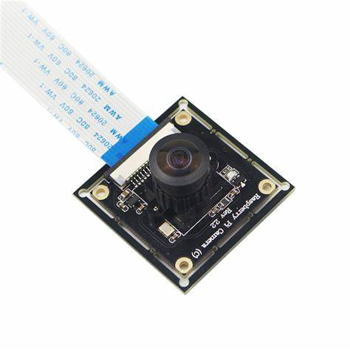
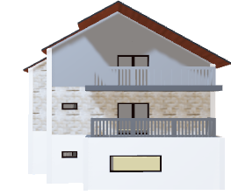
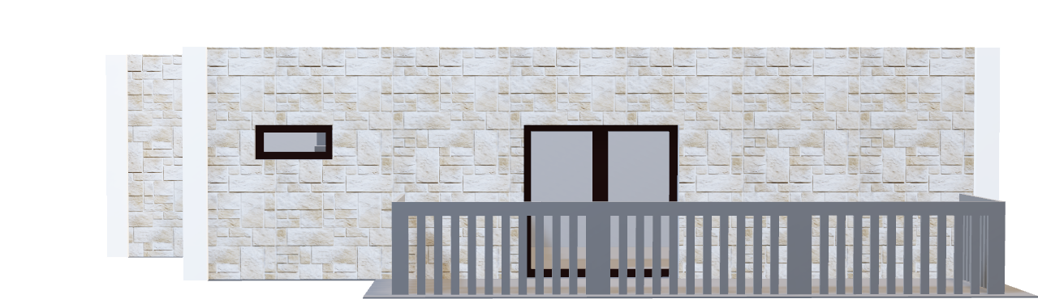

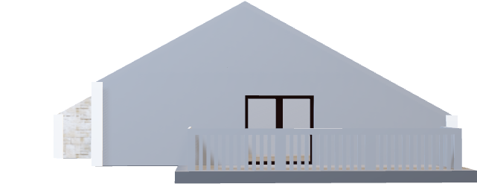
Camara sensor
A 12.3 megapixel Sony IMX477R sensor on the Raspberry Pi High Quality Camera offers significantly more pixels than the 8-MP Pi Camera V2, the previous first-party module which will remain on sale.

Slide 9
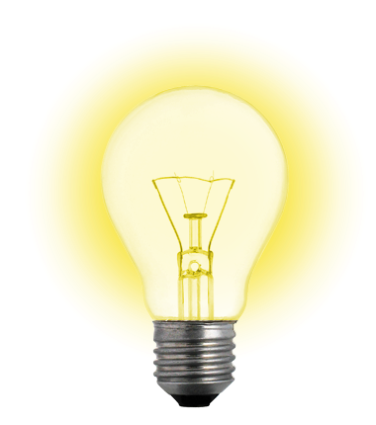
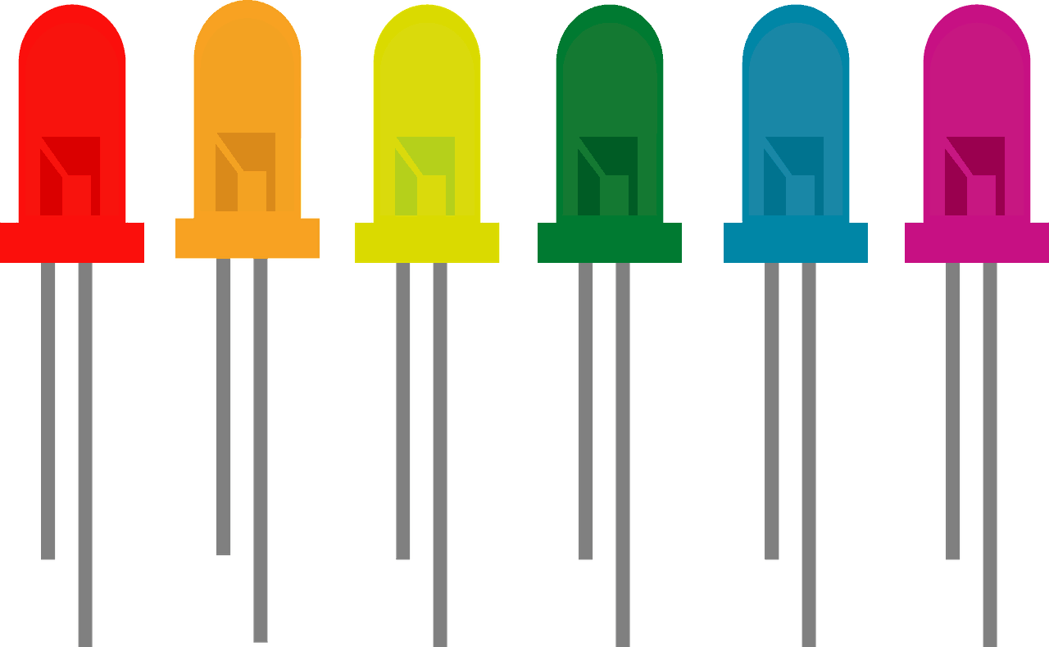
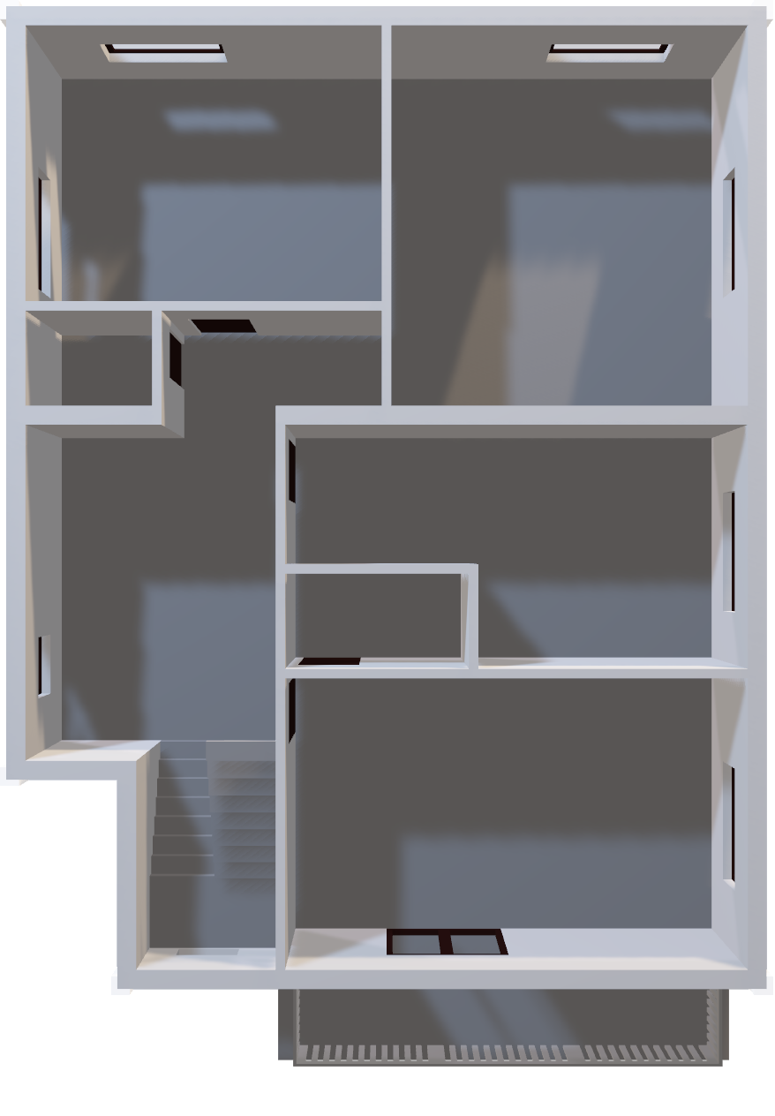
LED Sensors
Roof
In addition to emitting light, an LED can be used as a photodiode light sensor / detector. This capability may be used in a variety of applications including ambient light level sensor and bidirectional communications.
1st Floor

Slide 10
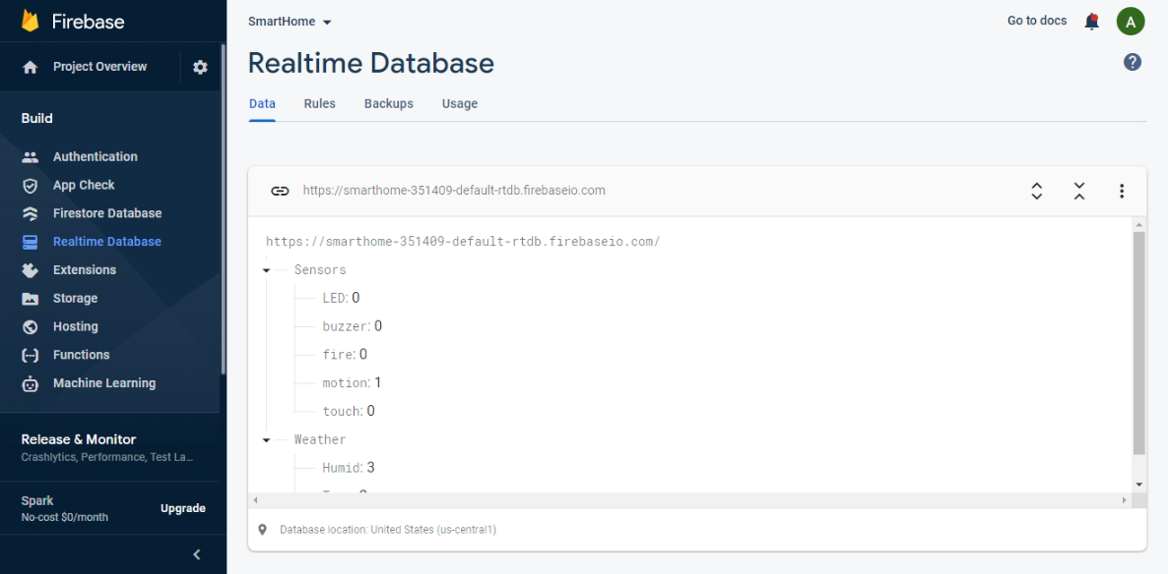

Slide 11
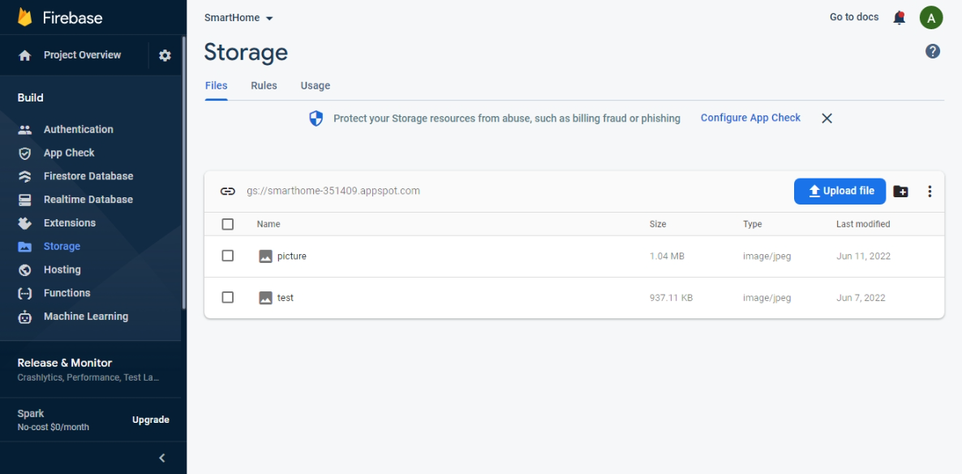

Slide 12


Slide 13

Thanks For Listening

